Slide 1

Momo Medical
Salah Abdulkader, Theo van den Berg, Roy Duivenvoorden, Nick Keereweer, Floris van Lingen, Jeanine Nagy

Slide 2
Table of contents
The project
What did we do?
Planning and managing the project
What are we going to do?
Notes:
Here you can see what the content is of our presentation. First we are going to refresh your memory of what this project is about. After that I m going to tell you what we did last week. Then I will tell some about how we go about planning and managing the project. Lastly I will give insight in what we are going to do next.

Slide 3
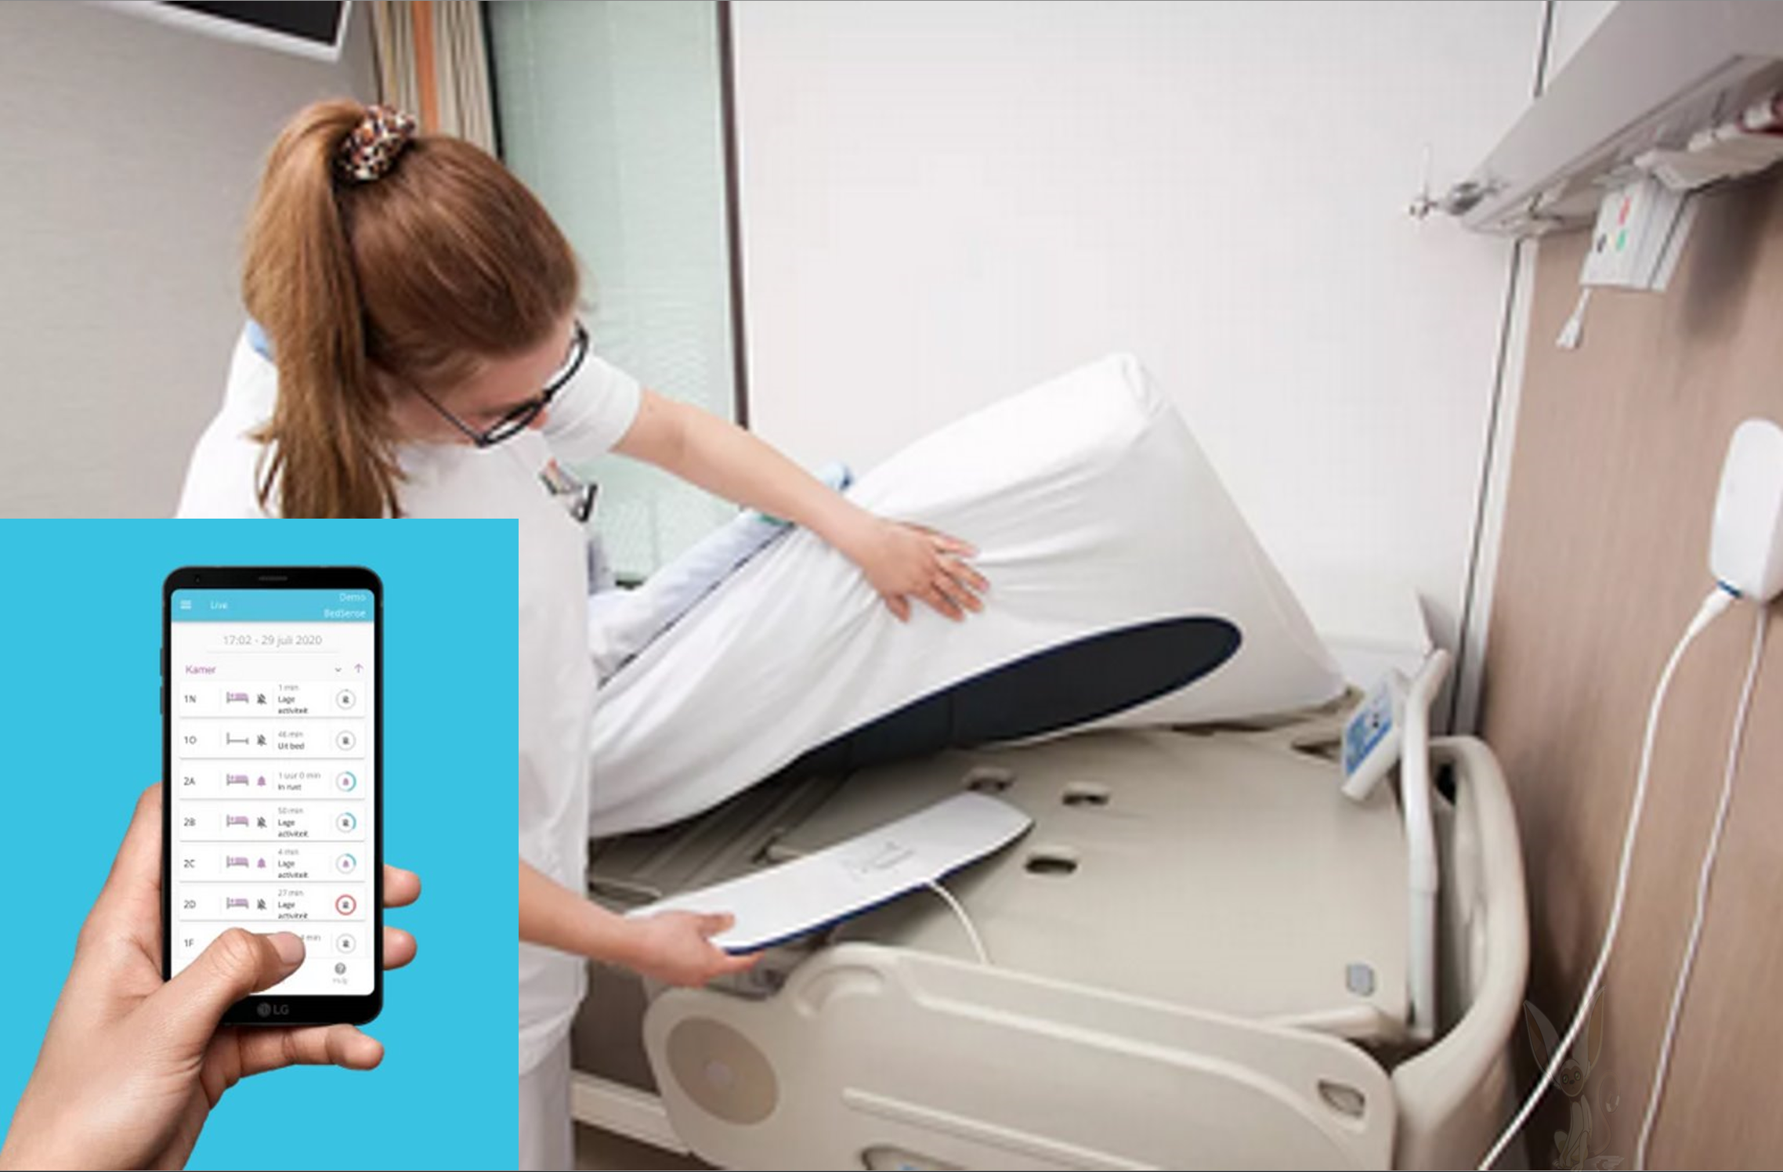
The project
Momo Medical is a start-up located in Delft
BedSense
Multiple sensors are located underneath the mattress
Goal 1 : Have less false positives
Goal 2: Predict when a patient is getting out of bed
Notes:
BedSense is an application which uses the data from multiple sensors, with the application employees are able to see the current status of their patients. If they are sleeping, if they are sitting on their bed or if they left their bed. These sensors are able to measure pressure and an algorithm is able to determine in what state the patient’s bed is.

Slide 4
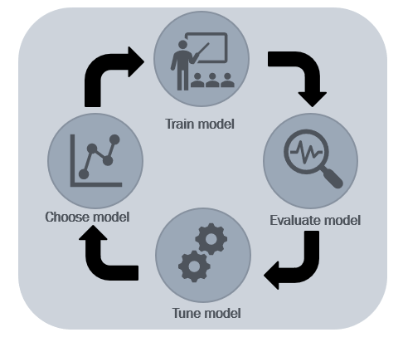
What did we do?
* Microsoft Teams meeting with Momo Medical
* Pre-processing the data and starting on a model
* Literature research
* Meetings with teachers
* Updated the project TrelloBoard
* Finally we are done with DataCamp
Notes:
So last week we did the weekly teams meeting with the product owner. We discussed our planning as well as the contents of our research proposal. Mostly the sample and population of our research and how we needed to validate our research. We also sent him the document so he could approve of the contents and give us some feedback.
We also did some literature research and have found some peer reviewed articles closely related to our project.
Of course we also did some more datacamp.
We have made a global planning as well. So we can estimated how much time we have left per step and so we can focus on getting some results next.

Slide 5
What have we done ?
We have made our first model
Teams meeting with Momo Medical’s Algorithm crew

Slide 6
Information about our first model
We have used Sklearn to make our model.
We have cleaned our data and sliced one sensor of it to
Make our first prediction model.
We used cross-validation for our test on the model.
Teams meeting with Momo Medical’s Algorithm crew

Slide 7
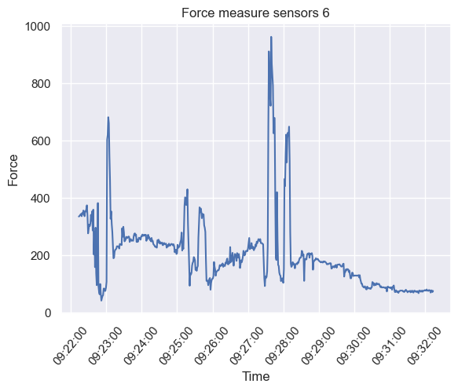
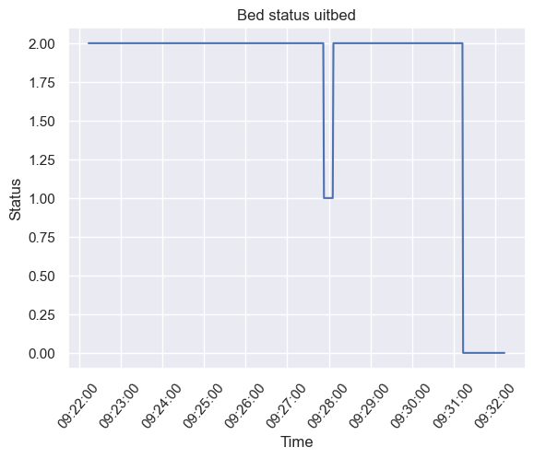
The sensor and The bed status
Bed Status
2 = sleeping in bed
1 = sitting in bed
0 = not in bed

Slide 8
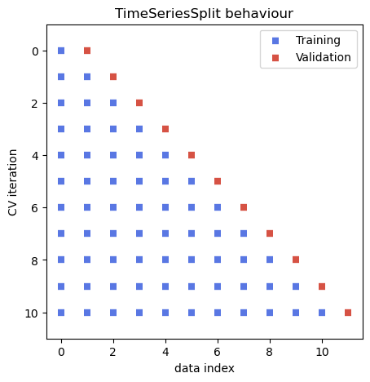
Time Series Split behaviour
This is an explanation about our test method.

Slide 9
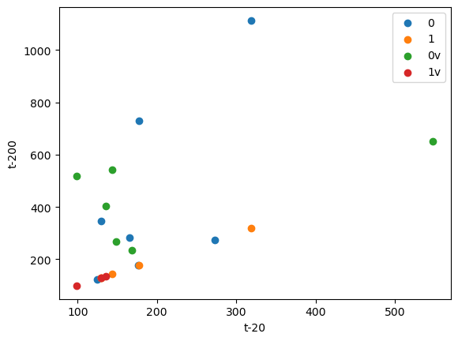
Scatter plot predictive model
First model prediction Data
Accuracy score = 0,55
200 seconds before
20 seconds before

Slide 10

Questions?

